Slide 1
LESSON FOUR
TOPICS: HOW TO MOVE THE CAMERA PROGRAMMATICALLY BETWEEN PRESET DESTINATIONS.

Slide 2
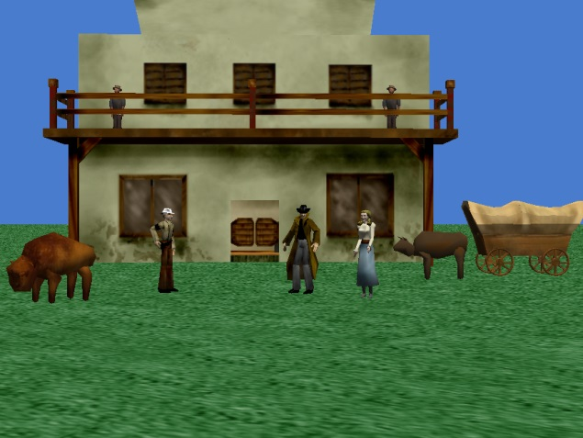
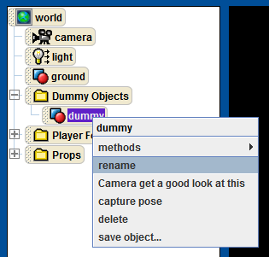
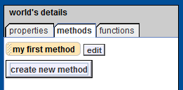
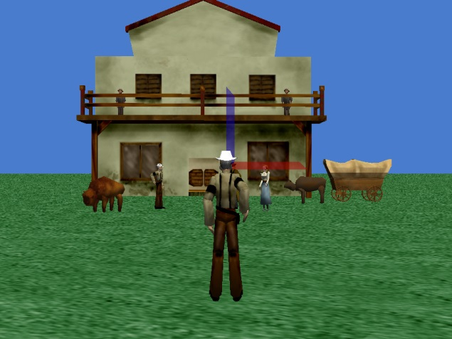
Step 1: Create a New Wold
Use the “set point of view” method to move the camera to the Player View dummy object.
Move the camera backwards 8 meters.
Add a new dummy object at the camera’s current position.
Rename the new dummy object “introPos.”
Create a new world method called “showIntro”

Slide 3
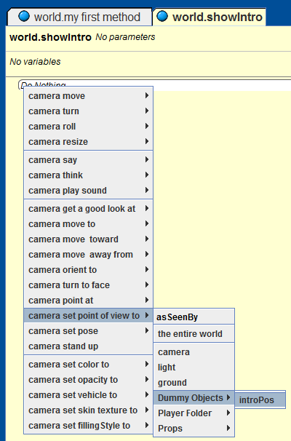
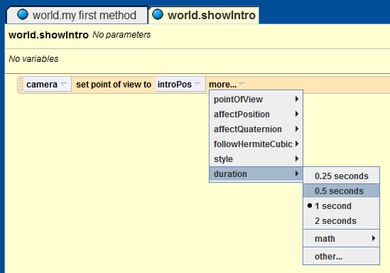
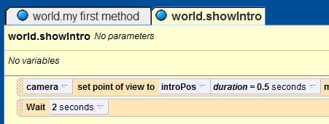

Step 1: Setup the Initial Camera Position
Drag the camera object from the object tree into the method body for the “showIntro” method that you just created.
From the pop-up window, select “set point of view to” “introPos.”
Set the duration for the point of view change to 0.5 seconds
Add a “Wait 2 seconds” command to the bottom of the “world.showIntro” method.
You can find the “Wait” function at the bottom of the code editor.
Notes:
Introduce the concept of animation. An animation does not have to be fancy. An animation is just programmatically instructing the computer to change something.

Slide 4

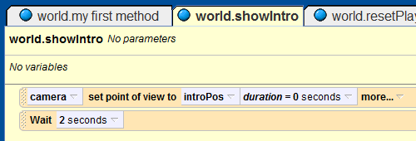
Step 1: Test the Initial Camera Position
Use the arrows on the world view to navigate away from the “introPos” dummy object.
Play your world. What happens?
Now change the duration for the first line in the “world.showIntro” method to zero seconds.
Now play your world. How is it different?
Notes:
Questions for students:
QUESTION: why might we want a duration of 0.5, or more, seconds?
ANSWER: If we want to see an animation occur then we need to give it a non-zero duration. All animations in Alice start with a default duration of 1 second.
QUESTION: why might we want a duration of 0 seconds?
ANSWER: If we want a change in our Alice world to occur instantly, such a scene change or an item pickup, then we want a zero duration so that the player does not see the change.

Slide 5
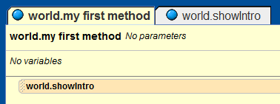
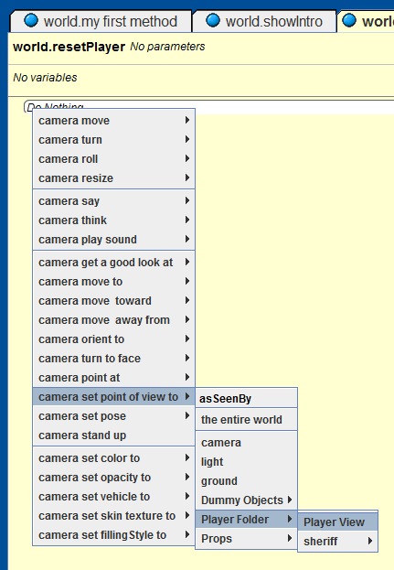
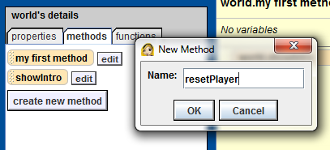
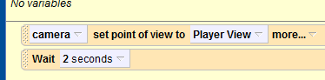
Step 1: Create a Player View Position
Add the “world.showintro” method to the “world.my first method” method.
Create a new method on the world object titled “resetPlayer”.
Drag the camera into the “world.resetPlayer” method and set it’s point of view to “Player View”.
Set the duration of the “set point of view” method to 0.5 seconds.
Add a “Wait 2 seconds” to the bottom of the
“resetPlayer”
function.

Slide 6
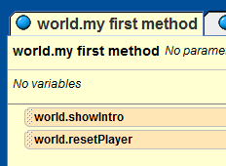
Step 1: Tell Alice to Move the Camera from the Initial Camera Position to the Player View Position
Add the newly created “world.resetPlayer” function to the bottom of the “world. My first method” function.
Play your world. Now what happens?

Slide 7
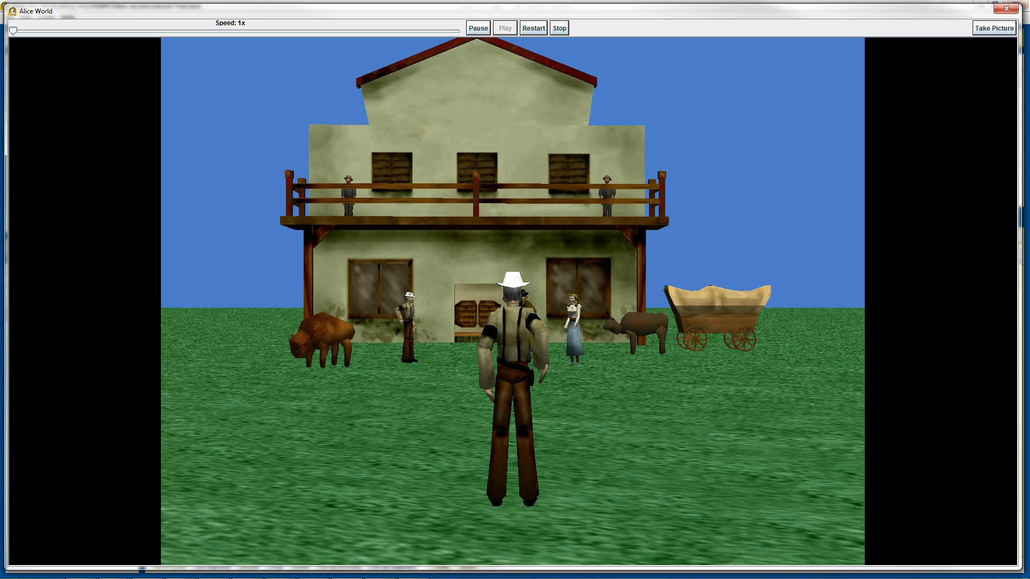
Final Scene

